Slide 1
YWCC307 Group Project
Joshua Amora, Ege Atay, Michael O’Hanlon, Christopher Rescinio

Slide 2
Scenario
North Carolina Department of Health and Human Services (the Department) goal for the transition to managed care is to improve the health of North Carolinians through an integrated and well-coordinated system of care that addresses both medical and nonmedical drivers of health. In a significant change from today’s structure, both Standard Plans and BH I/DD Tailored Plans will be fully integrated managed care plans with a benefits package that spans both physical and behavioral health services, as well as long-term services and supports (LTSS) and pharmacy benefits.
We are considering an alternative database product for this system to better serve these new data requirements. We compare three popular database products and suggest the best option following an objective criterion.

Slide 3
Project Plan
Agree upon the requirements for our database
Perform our own individual research based on the database of our choice
Compare each other’s findings and come to a unanimous decision for the database
Discuss how to present our findings.
Notes:
To figure out which database would base serve our needs, we came up with this 4 step plan. First, our group came up with what we would believe to be the requirements of our healthcare database. Since there was little information given in our prompt, we had to created a list with as much detail as possible for a common vision of our database. Next, we split up the research between us and carried our own individual research for a database we chose. This allowed to us to get as much information as possible within a reasonable timeframe. Then, we compared each other’s findings, including the advantages and disadvantages of our chosen database. Afterwards, we would come to a unanimous decision on the best possible database. Finally, we planned on how to present our research to a general audience. This includes a summary of our research and a reasonable conclusion on how we came to choose our solution.

Slide 4
Database
System that stores data in an organized manner
Data can be created, manipulated, and deleted
Reasons to use one
Easy data Retrieval
Record keeping
Security
Most common type of management system is relational database
Notes:
To start, let’s go over what is a database. Databases are systems that is able to store data inside one or more servers. This data can be created, manipulated and deleted. One of the reasons that companies use databases is for easy data retrieval. Whether it be their customer’s data or private information within the company, they can keep and access it within the same group of servers. Another reason is record keeping, meaning it is easier to have the most updated information instantly accessible for everyone that has access to the database. Finally, this would not be possible without good security in which the data is encrypted and not easily vulnerable. Databases themselves are accessed through database management systems, which are software packages allowing users to be able to access and change data. The most common one everyone is familiar with is relational database, where the data is stored in tables with different fields. Data can be linked across different tables through the use of primary keys, the primary identifier of the entry, and foreign keys, a field that points to another table. For our research, we looked into MySQL, Oracle Database, and Microsoft SQL Server.

Slide 5
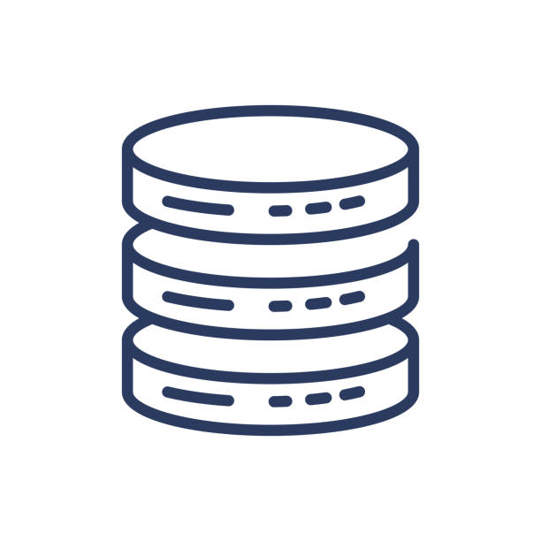
Requirements for Database Solution
Supports very large databases
Multiple health services
Has good security to hold sensitive data
Has to be Reliable and use back-ups to not
lose sensitive data
Easily updatable
Simultaneous user support
Multi-platform support
Supports charts
Low Priority Requirements:
While keeping costs low is great security and reliability are more important
Speed
Notes:
Our requirements for the database includes many features we believe are essential in healthcare. Our database must be able to support a large amount of data to be able to support the health records of North Carolina. It should also be able to work with multiple health services, meaning that the database should easily obtain a patient’s records from different areas of health. Some of the most important requirements is that the database should be both secure and reliable. For security, we do not want a database easily accessible with all of the patients’ record vulnerable to hackers. We are looking for features with levels of user access as well as good data encryption. For reliability, we want to make sure that our data can easily be recoverable in the event of an accident. We are also looking for our database to be easily updatable so that different parts in the healthcare system are not in conflict. The database should also support multiple users at once to accommodate the size of healthcare and speed of their operations. Multi-platform support is also important as offices may be working with older hardware and different operating systems. For the last of our important requirements, support of charts would be preferable to allow for detailed health records. Two requirements that are lower on the list include cost and speed. Cost is not as important as we believe that a secure and reliable database would be fully supported by the health department. Speed is also lower on our list as we would rather a slower, larger database than a faster, but smaller one.

Slide 6
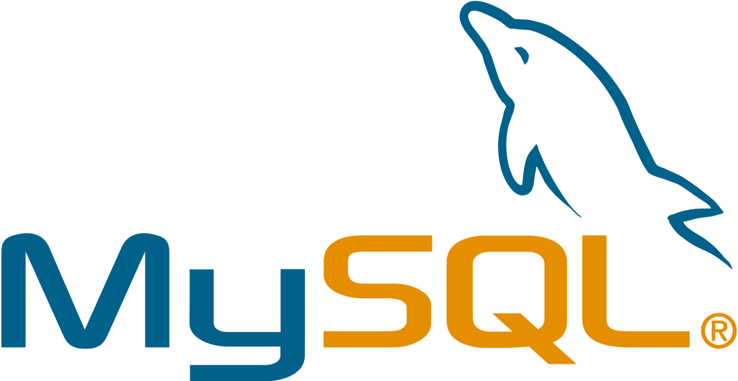
MySQL Positive
MYSQL is free to use although support will cost money if needed.
Multiple user interfaces to choose from.
MYSQL offers training and certification making it easy to hire or re-train current employees
MYSQL is compatible with a variety of databases
Known for its security
Notes:
MySQL is one of the most well known database products due to a lot of reasons. Most notably it is free to use, it only costs money if extra support is needed. It also has a range of user interfaces to choose from making it easy to customize and tailor to our specific needs. With a wide range of compatibility and training offered MYSQL makes it easy to convert to from other database products. The fact that it is open source means that there is a large amount of people who have experience in MYSQL. It has great security. Some of its security features include SSL encryption, data masking, authentication plugins, and firewall protection. Security is one of our most important requirements due the sensitive data this product is going to hold. And being free is also a great plus that MySQL has. It does however come with drawbacks.

Slide 7
MySQL Negatives
Some features like back-ups are difficult to implement
No built-in support for XML or OLAP
Is not efficient at handling large databases compared to its paid counterparts
Poor performance scaling
Poor development and debugging tools
Notes:
Since MySQL is free it does not include a lot of features that its higher priced competitors have. It is very difficult to implement some features that come with other database products such as back-ups, and support for things like XML and OLAP are non-existent. If we want to implement certain features, we would have to put aside time either training employees or finding someone with experience in what we need. The most glaring issue is its efficiency when it comes to larger databases. MySQL’s competitors are vastly more superior when it comes to handling large databases which is essential to our requirements. MySQL doesn’t stop there though as it has subpar development tools and performance scaling. While MySQL is a great database product in a lot of scenarios it’s weaknesses do line up with some of our most important requirements.

Slide 8
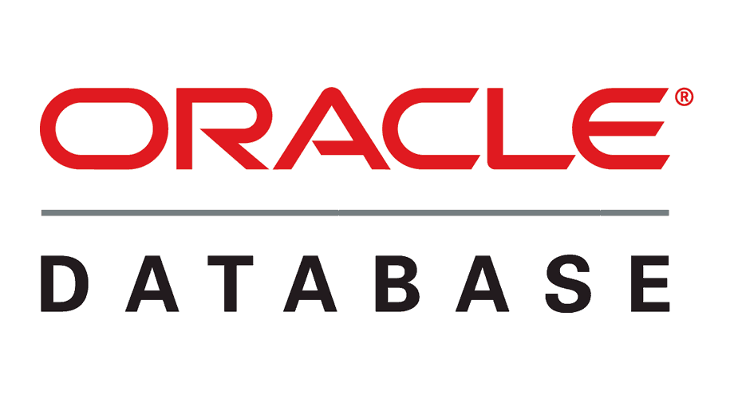
Oracle 12c Positives
Recover previous states as backup using Flashback Technology
Scalability for large and small databases
Multiple Database Support
Merge Multiple Databases into one
Security allowing for authorization and specific user actions
Notes:
For oracle database, it comes with many advantages. One of the best aspects of it is that it features its so called Flashback Technology. What this means is that at all data at any point in time can be recovered. This is especially useful if the data is accidently deleted or misplaced. It is also scalable for large and small databases, so the expandable size will be able to serve our needs. Oracle database also supports multiple databases within the same server. We can access multiple databases within the same command. If needed, all the databases can also be merged into one large one so that operational costs can be reduced. Finally, oracle offers many tools that allow us to customize individual user access and authorization for security. This feature is especially important for our healthcare database. The most appealing features of Oracle database are its scalability and data security,

Slide 9
Oracle 12c Negatives
Expensive especially compared to competitors
Computer resource intensive, requiring advanced hardware
Complex and difficult to learn
Difficult to manage
Only useful for larger databases
Notes:
One of the biggest issues when it comes to Oracle is that it can be expensive, especially compared to competitors such as Microsoft SQL where Oracle’s price can be up to ten times Microsoft’s price. While its scalability can help reduce costs, it can be expected that prices will still be higher. Another disadvantage is that it is heavily resource intensive, requiring advanced hardware to run. This just further adds to the cost and makes Oracle our most expensive database. Due to the advanced features of the database, Oracle is both difficult to learn and manage. Even once the healthcare database is running, workers still need to go through training to even understand some of the basics of the software. This process is both time consuming and costly as well. Finally this database is only really useful for larger databases as the price point might be too expensive for smaller use cases. The biggest hurdles to cover when using Oracles is its costs and usability.

Slide 10
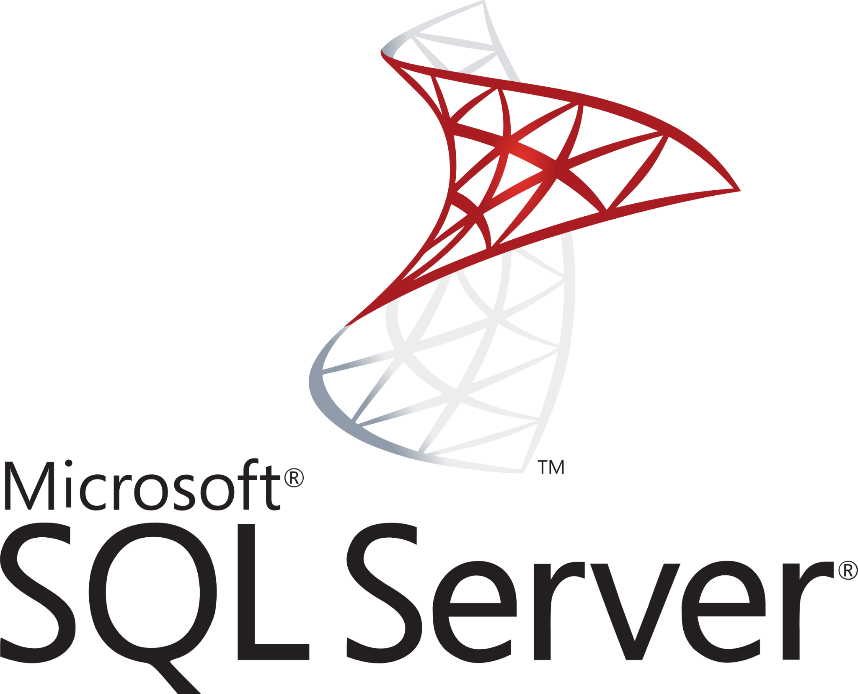
Microsoft SQL Server Positives
Multiple versions of the software
Support for use on Linux
Microsoft support
Plenty of online documentation
Data recovery and restoration features
Security with complex encryption
Notes:
Our next product we researched as a potential option was Microsoft SQL server. Starting with the positives, MIcrosoft SQL Server software comes in a variety of versions. These include Enterprise, Standard, Web, Developer, and Express. This is a good thing because it can allow us to further narrow down which version we would like based on the different features each version comes with.
Next, there is support for Linux based operating systems which is not necessarily a major concern of ours but it is nice to have. It will allow us to ensure that if there are pre existing servers running Linux, that it won’t be an issue installing them.
This product also comes with direct Microsoft support because it is a Microsoft product. This will allow us to ensure that should any issues arise, Microsoft support can be fallen back on.
Microsoft SQL Server has been around for decades, so there is a lot of online documentation for various versions that can be useful should any problems come up when using this product.
Next, something that we considered to be very important is the data recovery and restoration features. These features will be critical in the event of data loss, so the features implemented into Microsoft SQL Server will be important to have. There are options to restore the entire database or just a single file.
Finally, Microsoft SQL Server has complex encryption for security purposes, so in the event of a breach the data on it’s own will be useless without the corresponding decryption key and since this will be used for the Department of Health, we figure the more security the better.

Slide 11
Microsoft SQL Server Negatives
Can be expensive for Enterprise edition
Newer versions require newer hardware
Not supported on every major platform (Mac OSX)
Notes:
Moving onto the negatives of Microsoft SQL Server, there was little things we could find to go against this product.
First, the price for the Enterprise edition can be expensive, which is not a primary concern of ours but it is still worth noting. Microsoft lists the price of the Enterprise edition as roughly $14000 for the 2 core pack. Considering most servers are not going to be running on just two cores, this price can seriously increase.
Another gripe we found was that the newer versions of the software have increased hardware requirements which of course scales with the size of the database. We know the database will be large, so it is possible pre existing servers will need to be replaced or upgraded to run the database at its full potential. If this was the case, it could be quite expensive and time consuming to ensure all of the servers are either upgraded or replaced before officially making the switch.
Finally, there is no direct support for Mac based systems. Although it is unlikely that this would be an issue, it is still worth noting as a negative about this product.
So overall, there was not many things we could find as cons to this option.

Slide 12
Our Deliberation
Although MySQL would be free to use and has good compatibility with other databases, it was ruled out because of its poor performance and scaling of larger databases
Microsoft SQL Server ruled out due to its lack of support for Mac based systems
Notes:
When it came down to making a decision about which product would be right given our scenario, we looked at each option objectively given the research we conducted to come to a verdict.
First, we decided to rule out MySQL due to performance and scaling concerns. MySQL is still a good product in its own right, however we figured it would not be the best choice for the North Carolina Department of Health to use.
We were then left with Microsoft SQL Server and Oracle 12c. It was very difficult to come a decision between these two because their pros and cons are both very similar, but in the end we decided to go with Oracle 12c.
We ruled out Microsoft SQL Server due to its lack of support on Mac based systems, but we also decided that the Flashback Technology for data recovery and security features of Oracle would be something we wanted to have in our product.

Slide 13
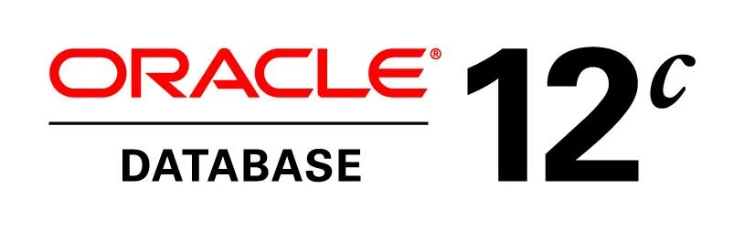
Our Recommendation
Oracle 12c is the best fit database product per our requirements
It does not suffer from the drawbacks of MySQL and Microsoft SQL Server
Its cons are not detrimental to our scenario
Notes:
Our recommendation is Oracle 12c as the new database product. We critically judged each product based on the database requirements we laid out at the start of the presentation.
To recap, our database must be scalable, accommodate multiple health services, have good security and reliability, offer support for simultaneous users and operating systems, and support charts. Oracle 12c offers what we are looking for the most.
While its major downsides are its learning curve and high costs, we believe that it is worth putting in the time and funding to use this product as the Department’s new database product. The benefits that Oracle has to offer will certainly pay dividends in the future.

Slide 14
References
https://www.keycdn.com/blog/popular-databases
https://learnsql.com/blog/microsoft-sql-server-pros-and-cons/
https://www.cherryroad.com/2021/10/22/oracle-database-cloud/
https://theninehertz.com/blog/advantages-of-using-oracle-database
https://www.mysql.com/
https://www.techstrikers.com/MySQL/advantages-and-disadvantages-of-mysql.php
https://www.rothmobot.com/the-advantages-and-disadvantages-of-microsoft-sql-server/
https://www.c-sharpcorner.com/article/introduction-to-databases/
Notes:
Finally, we have a list of all of the references we used for our information.

